Slide 1
Basic Mesh Modeling
Sustainability
By Friend

Slide 2
Pre-workshop
Read and do stuff assigned in sections up to and including “Install and open Blender”

Slide 3
If there’s a word you don’t understand in the slide, let me know and I’ll add it here

Slide 4
Note
If it’s a keyboard shortcut, I’ll use [ ]
If it’s a mouse click, I’ll use “ ”

Slide 5
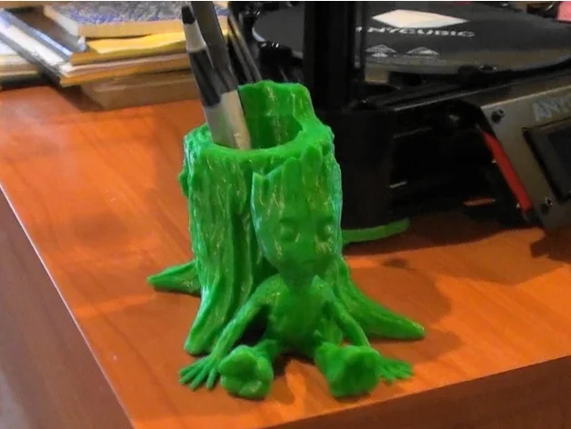
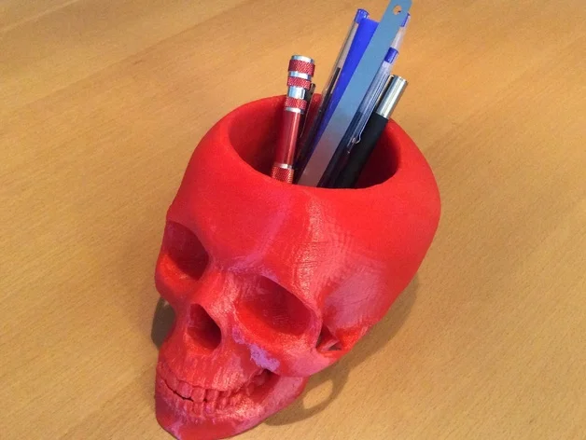
Agenda
We’ll walk through the process of making something similar to this pencil cup
https://www.thingiverse.com/thing:2143549
https://www.thingiverse.com/thing:933001
You’ll learn some Blender basics along the way
Enough to get you through 90% of 3D printing prototyping

Slide 6
Why Blender is better than Solidworks (sometimes)
#1: Save time (and money)
For most basic, first iteration prototypes, most likely someone’s already made something similar that you can adapt to your project
And they’ve put it up for free, online
Adapting it to your ideas is less time, compared to CAD something from zero
Popular 3d-print-able format for 3D models is STL (mesh, not CAD files, unfortunately), so Blender is better suited than Solidworks
#2: You can do everything Meshmixer does with Blender, and more
Some examples:
Closing hole: https://blender.stackexchange.com/questions/52661/how-can-i-close-a-big-hole-in-a-mesh
Plane cut: https://blender.stackexchange.com/questions/88578/how-do-i-bisect-along-an-axis
Much larger user community than Meshmixer
Someone’s already answered any question to anything you need to fix in Blender
Many useful Blender plugins people write and put up for free
You can do animation, video editing, modeling, etc. (and even CAD if you want to)

Slide 7
Find models
The main elements of this project are:
A model
A hole
A bottom plate if the hole cuts through the model, or model doesn’t stand on itself
We can make the hole and the bottom plate in Blender, so for now, find a nice model on thingiverse.com you want to put a hole through
Good if it’s solid block that stands on its own
Ideas: dogs, cats, skull, moon, globe, turtle, bunny, R2D2, mushroom cloud

Slide 8
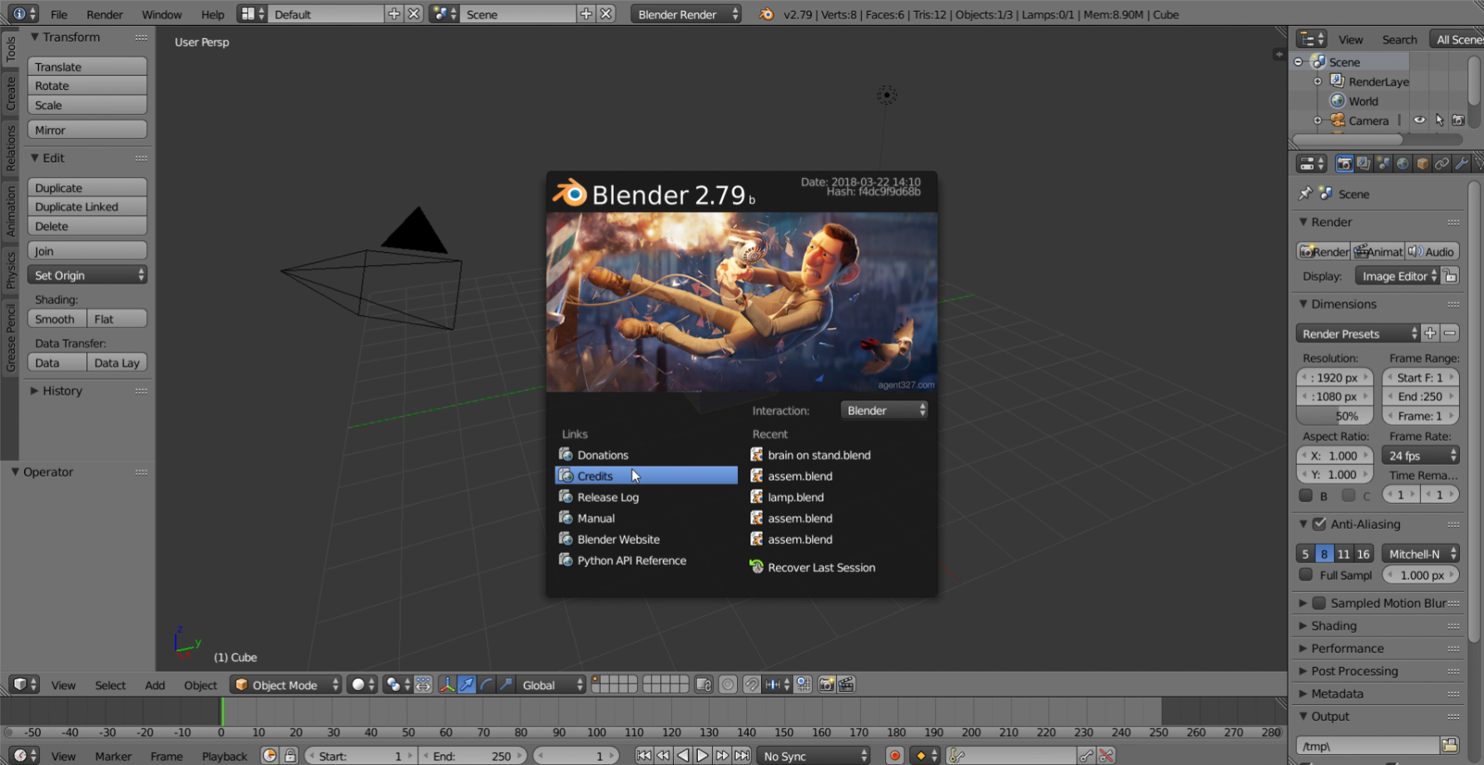
Install and open Blender
Go to blender.org, download, and install
It’s a fairly clean website unlike Lulzbot’s so I won’t go into detail
I’ll use Blender 2.79 in this workshop
Blender 2.80’s new UI is easier to use, but there isn’t as much resources on it online yet, so I’ll stick with Blender 2.79
Open it once you’re done, click anywhere outside the center to make the middle pop up go away

Slide 9
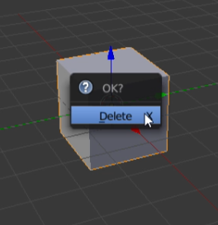
Install and open Blender
Get rid of the default cube by pressing [X] and click “Delete”

Slide 10
Manipulate your view
To rotate view, hold middle mouse button, and drag your mouse
To move view, hold [Shift] and middle mouse button, and drag your mouse

Slide 11
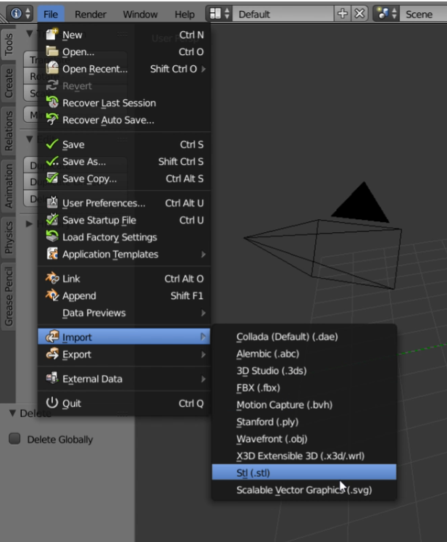
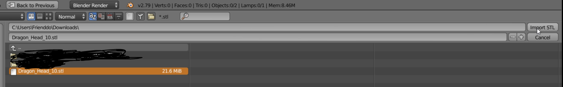
Import and center your model
To import, click “File” (top left corner) -> “Import” -> “Stl (.stl)”
Go to the folder, click on the file, then click “Import STL”
I picked this https://www.thingiverse.com/thing:478774

Slide 12
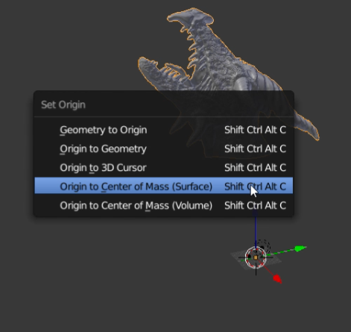
Import and center your model
STL are sometimes not centered to origin
If you don’t see it, use the middle mouse scroll, and zoom out until you see it
Press [Shift]+[Ctrl]+[Alt]+[C], then click “Origin to Center of Mass (Surface)”
You can use Volume as well; they’re approximately the same

Slide 13
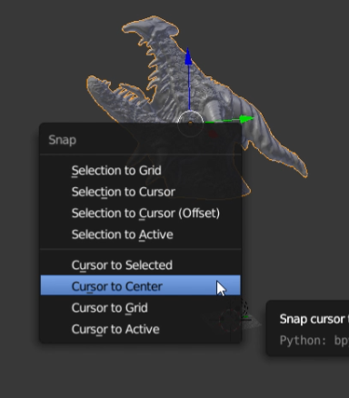
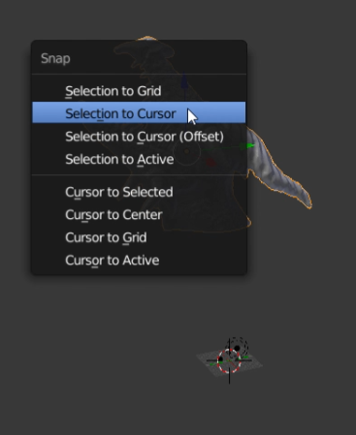
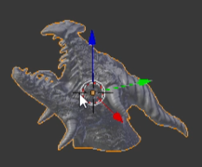
Import and center your model
Press [Shift]+[S], click “Cursor to Center”
Click “Selection to Cursor”
Your model should snap to center of the world now

Slide 14
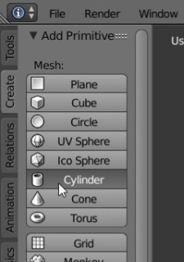
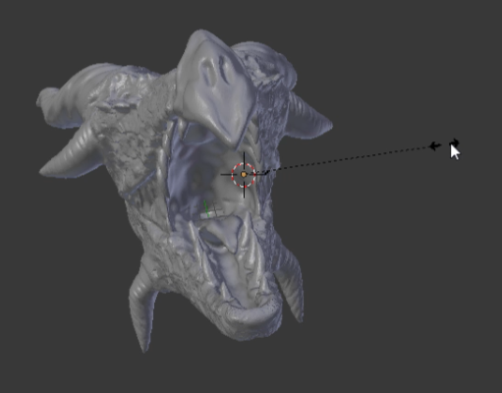
Make a hole
Click “Create” -> “Cylinder”
We’ll use this model to as the hole
You can make a square, or a cone hole too if you want
Before you click anything else, press [S] and drag your mouse outwards
This will scale up your cylinder

Slide 15
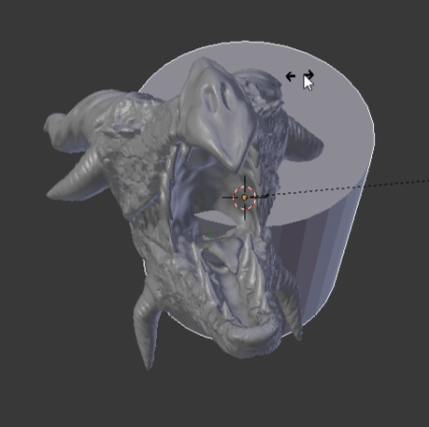
Make a hole
Once it’s to a scale that you can see, stop
To move the model, click [G]+[x/y/z]
To move along the local axis, rather than global axis, click [G]+[x/y/z]+[x/y/z]
To rotate the model, click [R]+[x/y/z]
To rotate along the local axis, rather than global axis, click [R]+[x/y/z]+[x/y/z]
To scale the model, click [S]+[x/y/z]
To scale along the local axis, rather than global axis, click [S]+[x/y/z]+[x/y/z]

Slide 16
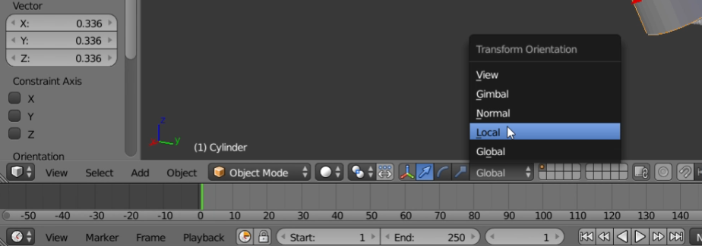
Make a hole
It might be hard to visualize rotating or scaling along local axis without seeing local axis, so you can change that on the bottom toolbar

Slide 17
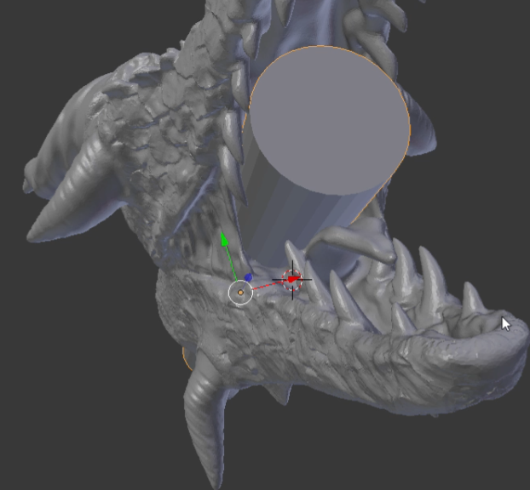
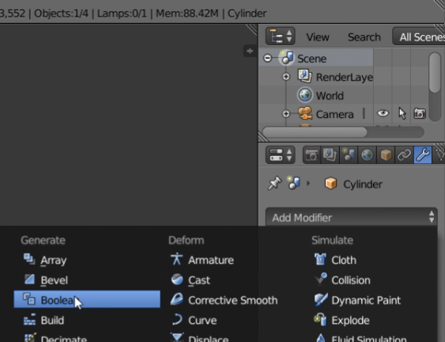
Make a hole
Once you have put it in the right position, go to the right toolbar, click on the wrench icon -> “Add Modifier” -> “Boolean”
THE IMAGE IS WRONG! You should select the main object, not the cylinder when applying boolean
You want to cut the hole in the dragon, not cut a dragon-shape hole in the cylinder

Slide 18
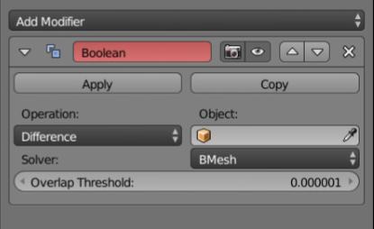
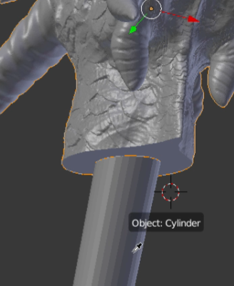
Make a hole
Change Operation to “Difference” (it’s a drop down menu)
Use the eyedrop icon near Object to select your cylinder

Slide 19
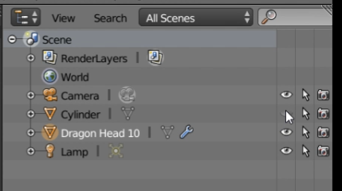
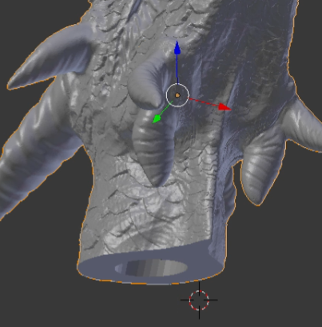
Make a hole
Click on the eye icon next to the cylinder’s name to not see it
You should be able to see the hole you’ve made very clearly

Slide 20
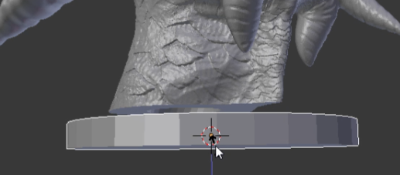
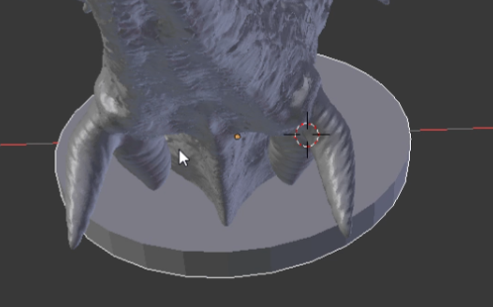
Make a base
Use the skills you learned when moving, rotating, and scaling a model to make the base
Make another cylinder and manipulate it into a base
Make sure the main model (ex: dragon) overlaps a bit with the base so it can become a single solid model

Slide 21
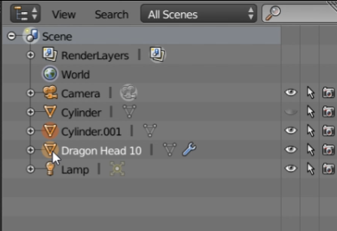
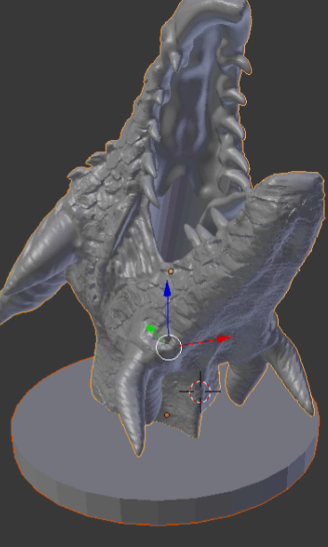
Exporting
Select only the model you want to export (hold [Shift] to select multiple things at once)
If you haven’t noticed by now, a model that is selected has an orange highlight around it

Slide 22
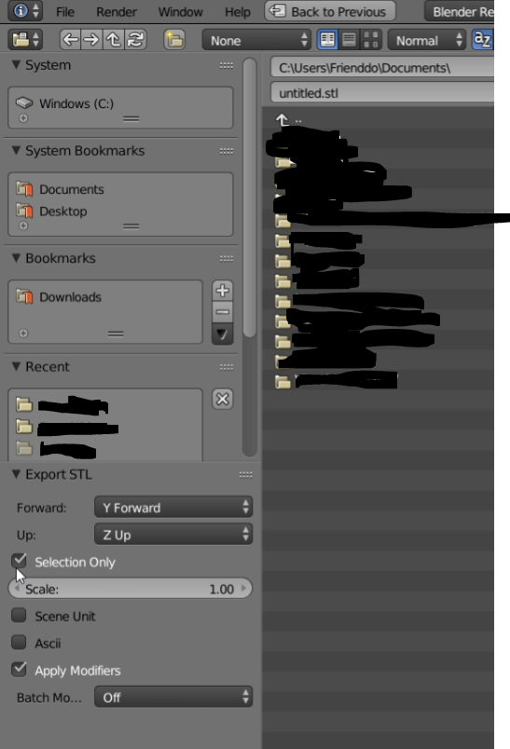
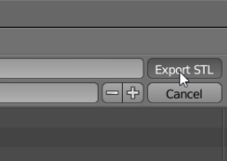
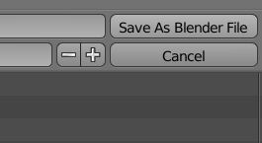
Exporting
Tick yes on “Selection Only” and “Apply Modifiers”
This will make sure only the stuff we’ve selected is exported (so the hole model doesn’t get exported), and the hole is actually cut into the main model
Save it anywhere you’d like by clicking “Export STL”
Save the whole Blender project by pressing [Ctrl]+[S], find a good directory, then click “Save As Blender File”
It’ll say “Save As” the first time you save

Slide 23
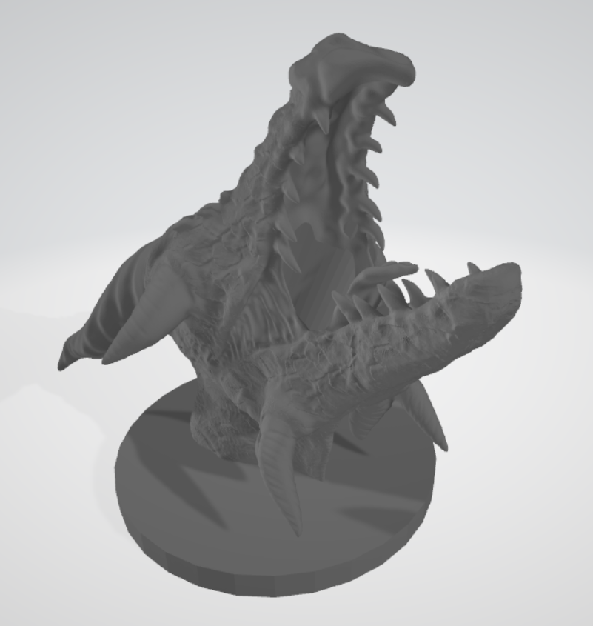
Final product
Nice
You can open it with 3D viewer (Windows) or Preview (Mac)
Import it to Cura to print

Slide 24
Other useful/cool stuff I didn’t mention
In edit mode, [Alt]+[S] to shrink/fatten
Good for clearances
In object mode, there’s Decimate as one of the boolean operations
Use to make low-poly toys

Slide 25
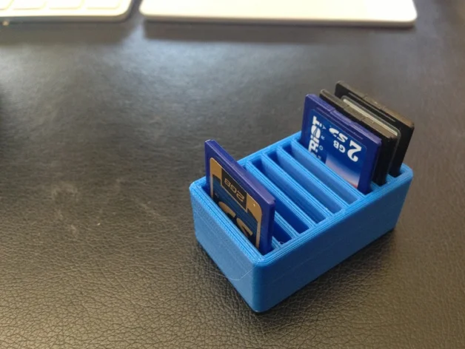
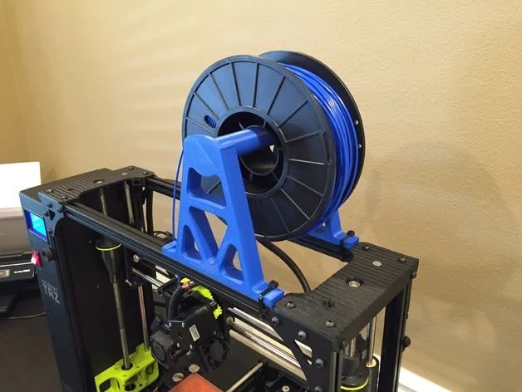
An example of what I’ve made using this method: SD card holder attached to 3D printer
SD card holder with boolean difference to cut it to have only one SD card slot
https://www.thingiverse.com/thing:56074
Spool holder with boolean difference to cut out for only the section to slot into aluminum extrusion
https://www.thingiverse.com/thing:1608830
Export them together

Slide 26
Some further readings
Modeling organic shapes https://blender.stackexchange.com/questions/45925/whats-the-best-way-to-model-organic-shapes
Physics simulation https://github.com/jonbruner/blender/tree/master/Cloth

